Slide 1


Grants Coffee Talk:
Telling the Story

Slide 2
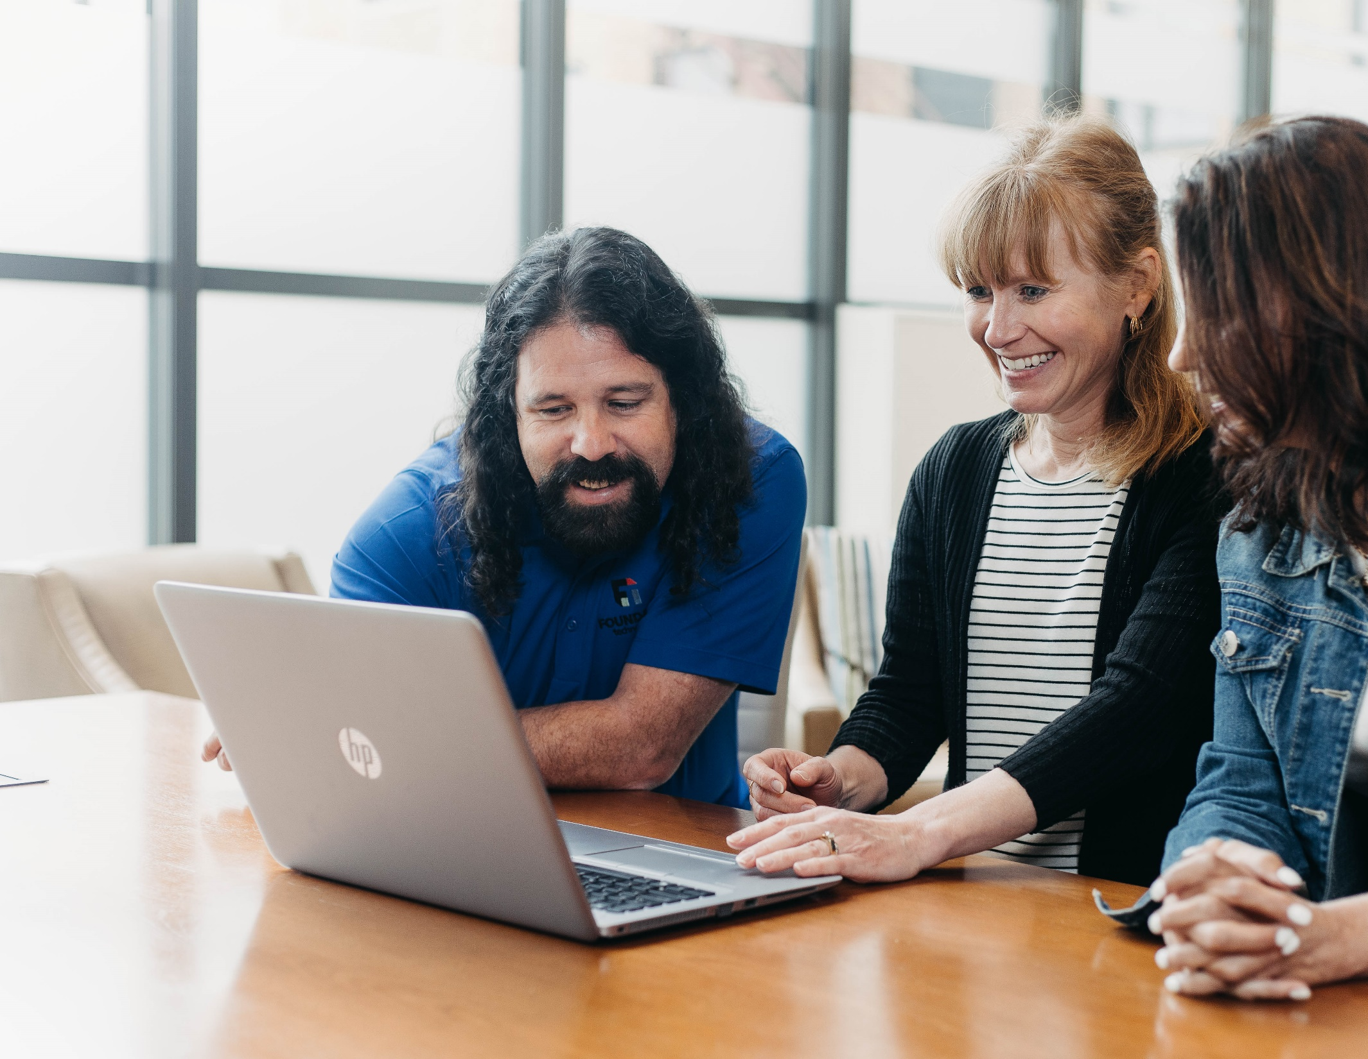

Coffee Talk
Expectations
Who gets the conversation started? Foundant
Who shares experience, advice, and challenges? You!
Who deals with all the questions and virtual "raised hands"? Foundant
Who participates in an open forum to share experiences and learn from one another? You!

Slide 3



Slide 4
Today's Facilitators
Meredith Edwards
Implementation Specialist
Joshua Bernard
Implementation Specialist

Slide 5

Questions for Today's Discussion
1
What story or stories do you want to tell?
2
How do you tell your stories now?
3
Why do you want to tell your story in a better way?

Slide 6

What story or stories do you want to tell?
Who is your audience?
Where do you want to tell your story?

Slide 7
How do you tell your stories now?
Visual, narrative, word-of-mouth, data-heavy, presentations
Case stories

Slide 8
Why do you want to tell your story in a better way?
Show your impact
Encourage donations
Increase awareness
Provide updates to stakeholders

Slide 9
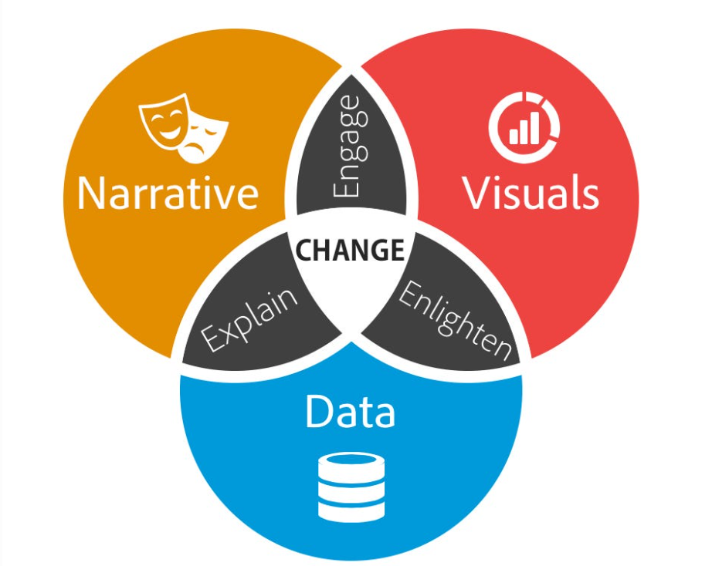
How can we "maximize the impact" of giving?
https://www.forbes.com/sites/brentdykes/2016/03/31/data-storytelling-the-essential-data-science-skill-everyone-needs/?sh=4fb7850752ad

Slide 10
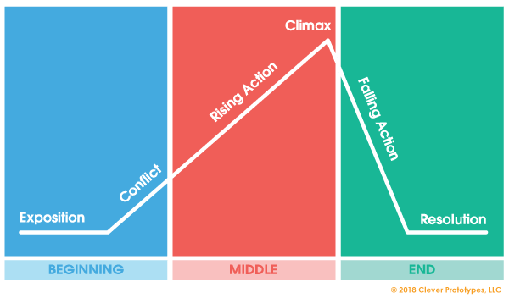
Narrative vs. Data: What makes a story?

Slide 11
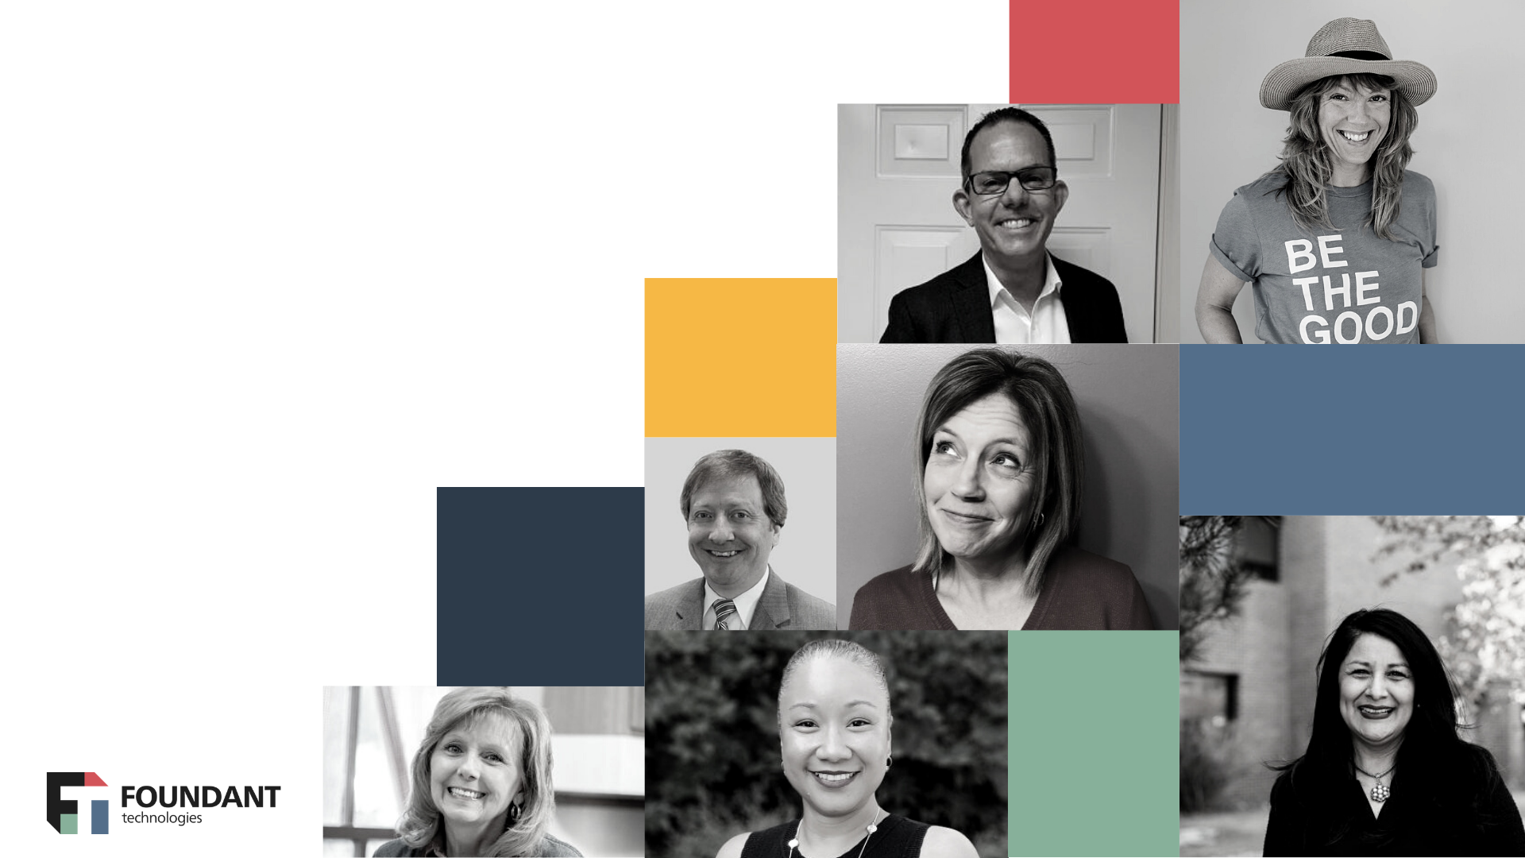

Compass:
Foundant's Community for Philanthropy
Keep the discussion going!
community.foundant.com

Slide 12

Thank you for joining!

